Slide 1
Monopolistic Competition

Slide 2
Monopolistic Competition
Monopolistic Competition
  A market situation in which a large number of firms produce similar but not identical products
  Entry into the industry is relatively easy

Slide 3
Monopolistic Competition
Characteristics of monopolistic competition
  Significant number of sellers in a highly competitive market
  Differentiated products
  Sales promotion and advertising
  Easy entry of new firms in the long run

Slide 4
Monopolistic Competition
Implications of the large number of firms
  Small market share
  Lack of collusion
  Independence

Slide 5
Monopolistic Competition
Product Differentiation
  The distinguishing of products by brand name, color, and other minor attributes

Slide 6
Monopolistic Competition
Product differentiation and price
  Differentiate perfectly
    Producer is a monopoly
      Significant influence on price
  Differentiation is not perfect
    Producer is a monopolistic competitor
      The more successful it is at differentiation, the more control it has over price

Slide 7
Monopolistic Competition
Sales promotion and advertising
  Can increase demand for a firm
  Can differentiate a firm’s product
  Should be continued to the point at which the additional revenue from one more rupee of advertising just equals that one rupee of marginal cost

Slide 8
Short-Run Equilibrium with Monopolistic Competition (with profits)
Panel (a)
MC
ATC
P₁
d
ATC
• Price (P₁) > ATC
• Economic profit
Dollars per Unit
A
Profits
MR
q
Quantity
Figure 26-1, Panel (a)

Slide 9
Short-Run Equilibrium with Monopolistic Competition (with losses)
Panel (b)
MC
ATC
ATC
Dollars per Unit
P₁
d
Losses
A
-Price (P₁) < ATC
-Economic loss
MR
q
Quantity
Figure 26-1, Panel (b)

Slide 10
Short-Run and Long-Run Equilibrium with Monopolistic Competition (break even)
Panel (c)
MC
ATC
P₁
=
T
ATC
d
Dollars per Unit
A
-Price (P₁) = ATC
-Normal rate of return
MR
q
Quantity
Figure 26-1, Panel (c)

Slide 11
Comparing Perfect Competition with Monopolistic Competition
Perfect Competition
Monopolistic Competition
One of many sellers , no barriers to entry, and no long term profit
Perfectly elastic demand (price taker)
Must only produce more
to sell more
All units sold for price equal to MR (P=MR)
One of many sellers, no barriers to entry, and no long term profit
Faces elastic market demand (price maker)
Must lower price
to sell more
All units sold for price greater than MR (P>MR)

Slide 12
Comparing Perfect Competition with Monopolistic Competition
In perfect competition, the long-run equilibrium occurs where average total cost is minimized.
This does not occur in monopolistic competition.
Some have argued that this is not necessarily a waste of resources, as the added cost arises from product differentiation that allows consumers to have more choice.

Slide 13
Comparison of the Perfect Competitor with the Monopolistic Competitor
Panel (a)
Panel (b)
Perfect Competition
Monopolistic Competition
MC
ATC
MC
Minimum ATC
ATC
Minimum ATC
d
P
2
P
1
MR =
P
Dollars per Unit
Dollars per Unit
d
MR
q
1
q
2
Quantity per Time Period
Quantity per Time Period
Figure 26-2, Panels (a) and (b)

Slide 14
Brand Names
Firms use trademarks, words, symbols, and logos to distinguish their product brands from goods or services sold by other firms
A successful brand image contributes to a firm’s profitability

Slide 15
Advertising
Forms of advertising
  Direct marketing
  Mass marketing
  Interactive marketing

Slide 16
Advertising
Search goods have characteristics that can be evaluated prior to purchase
Experience goods, such as movies and haircuts, don’t fully reveal their value until they have been consumed
Credence goods, such as pharmaceuticals and professional services, usually require an expert source of information to make a choice.
Advertising for experience goods is more likely to be persuasive rather than informational

Slide 17
Information Products and Monopolistic Competition
Information products, such as computer operating systems, software, and digital music and videos, have a unique cost structure
Product development entails high fixed costs, but the marginal cost of producing a copy for one more customer is low (This is similar to that of a natural monopoly.)

Slide 18
E-Commerce Example:
Pop-Up Ads
There have been court cases involving the use of pop-up ads to promote competing products when internet customers place online orders.
The legal rulings have been moving in the direction of allowing more interactive advertising.

Slide 19
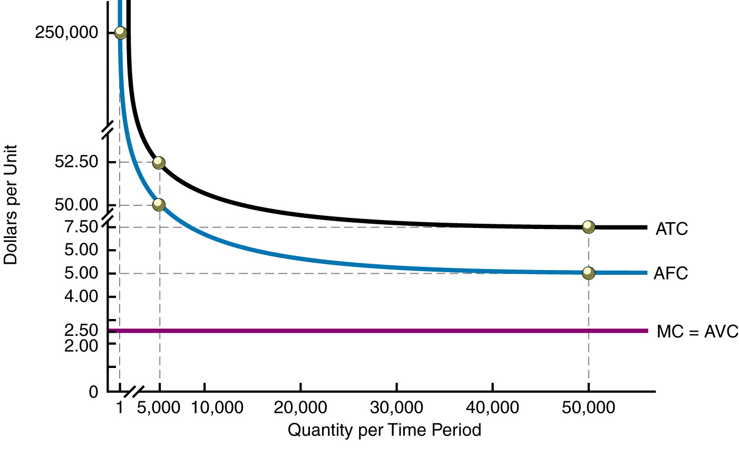
Cost Curves for
Information Products
Figure 26-4

Slide 20
Cost Curves for Information Products
Sellers of information products experience short-run economies of scale.
The average total cost continually declines as quantity increases. (This is also similar to the condition faced by a natural monopoly.)

Slide 21
Monopolistic Competition and Information Products
Computer game manufacturers operate in a monopolistically competitive market.
In monopolistic competition, marginal cost pricing results in losses for the firm, even though it creates efficiencies for the economy as a whole.

Slide 22
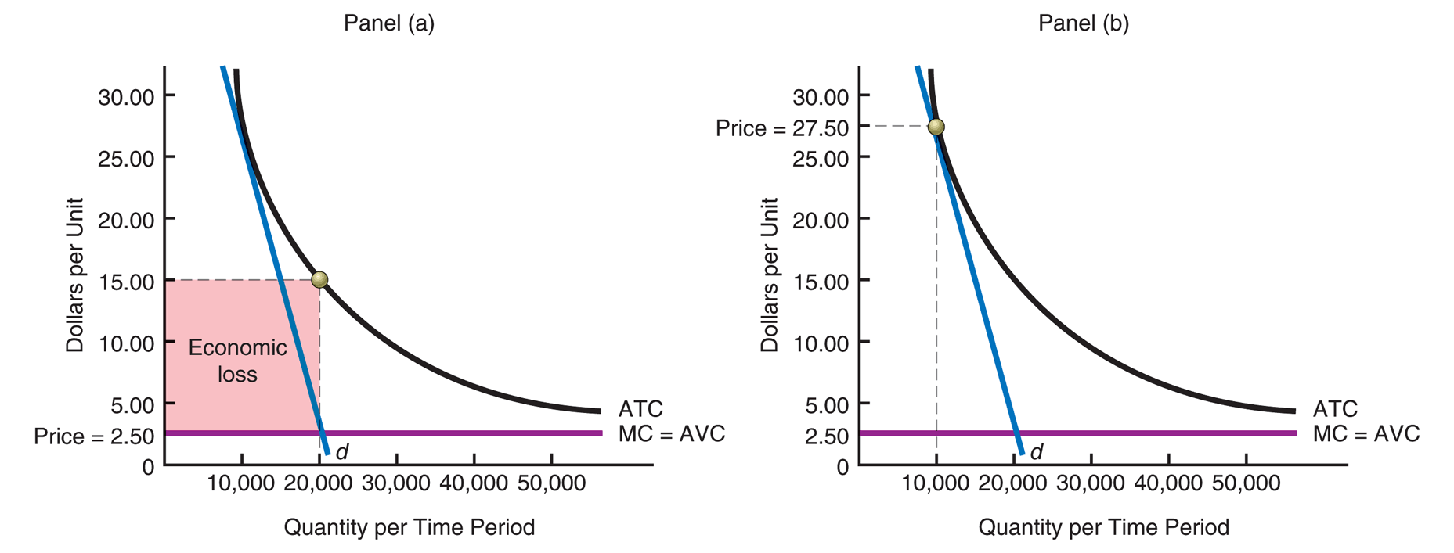
Infeasibility of Marginal Cost Pricing of an Information Product
Figure 26-5, Panels (a) and (b)

Slide 23
Pricing for Information Products
In the long-run, price will equal average total cost.
This yields the long-run equilibrium condition of zero economic profit.
Firms selling information products in a monopolistically competitive industry will recover all their production costs.
Customers will pay more than marginal cost, but they will pay the minimum price necessary to call forth the product to market.
Note: In the case of a natural monopoly, the firm does not face competition. The demand curve for the firm is that of the entire industry, so the result is a price that tends to exceed ATC. That is why long term economic profits are possible.

